Slide 1
Assessing Home Values
By: Vladimir Antasiuk & Nick Zelada
project for STA6244

Slide 2
Goal
House prices are a crucial indicator of the economic condition, and it is also a point of great interest for buyers and sellers. Both parties are interested in the factors that affect the price. Our project's primary purpose is to implement the knowledge, instruments, and techniques learned in class in solving real-world problems to identify factors affecting a home sale price.

Slide 3
The implementation of the project
Literature review and real world applications
Data exploration: sample statistics, graphs, normality tests, checking for missing values (We are working with a train set).
Best subset selection to choose the linear regression model
Evaluate the training model and apply to a training set

Slide 4
Literature review and real world applications
The paper by Quang Truong et al. (2019) Examines and compares the accuracy of such Machine Learning methods as Random Forest, XGBoost, and LightGBM. Hybrid Regression and Stacked Generalization Regression are two machine learning techniques predicting house prices using the “Housing Price in Beijing” dataset.
Dubin (1998) uses OLS regression to predict house prices based on different features using the data from multiple listings from Baltimore and Maryland (1978).
Zillow Company.

Slide 5
Dataset Description and Data Exploration
The dataset we will use for this project is the "Ames Housing Data" created by Dean De Cock. As a professor, he used the famous Boston Housing Data Set for his regression class as a part of his work. However, this dataset only contains 506 observations and 14 variables and quite outdated: the original dataset came from the 70s. To obtain a more relevant dataset, Dean De Cock, in collaboration with the students of Iowa State StatCom and the Ames City Assessor's Office, created the new Ames Housing data set.
Data runs from 2006 to 2010 with house sales in Ames, Iowa.
The original data set contains 2930 observations and 79 explanatory variables. The dataset from kaggle is divided into training and test set 1460 observations each and 79 explanatory variables (23 nominal, 23 ordinal, 14 discrete, and 20 continuous). The test set does not have the real values of the target variable. Some values of the predictors are missing.
Contains factors in assessing home values such as lot size in square feet, number of fireplaces, the pool area in square feet, number of kitchens, kitchen quality, type of roof, overall material, and many more.

Slide 6
Discussion of methods and instruments
The main method we used is Multiple OLS Linear Regression.
Linear Regression usage will allow us to make accurate predictions on house prices from the dataset and see any correlation.
To evaluate the precision of the model we chose adjusted R-squared and MSE as a metrics
For the linear regression we use F-test. Ho:Contributing factors of a house do not affect the price of houses, Ha:Contributing factors of a house affect the price of houses.
For the normality test we used Shapiro-Wilk test where Ho is that data comes from normal distribution.
To choose the best subset for linear regression we use ‘Leaps’ library in R. We used AIC criteria to pick the best subset.The model with the smallest AIC was chosen.

Slide 7
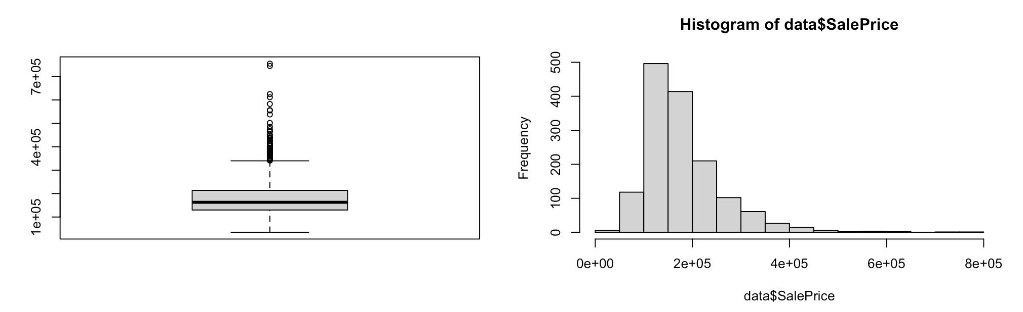
SalePrice Summary Statistics
fivenum(data$SalePrice):34900 129950 163000 214000 755000
mean(data$SalePrice) 180921; sd(data$SalePrice) 79442.5,
Mean>median, higher tail>lower tail, so it’s right skewed (highly right skewed (1.88)) and leptokurtic-kurtosis is 9.5.

Slide 8
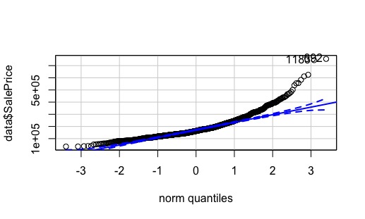
Shapiro-Wilk normality test
shapiro.test(data$SalePrice) W = 0.86967, p-value < 2.2e-16
So, p-value is less than 0.05, so we reject the Ho, thus there is not enough evidence that data comes from normal distribution.

Slide 9
The Best Subset Selection
With the high number of variables in the dataset and some issues with the variables, we could not run the subset selection on the full dataset due to R errors. A high correlation between some variables could have caused it. Instead, we manually constructed our regression model, taking the problem's logic into account.
found a model that consists of 27 predictors and an accuracy of about 84% (adjusted R-squared)
cleaned the data by using the na.omit() function
add 7 variables randomly to 27 chosen initially to see if the best subset selection can improve the precision of the model

Slide 10
Final model
SalePrice ~ OverallQual + GrLivArea + Neighborhood + RoofMatl + HouseStyle + ExterQual + BldgType + BsmtFinType1 + YearBuilt + OverallCond + LotArea + Fireplaces + PoolArea + MasVnrType + MasVnrArea + Condition1 + LotConfig + Foundation + LandSlope + BsmtFinType2 + LowQualFinSF + YearRemodAdd + Exterior1st, data = data_subset_sel_Clean)
Residual standard error: 27730 on 1314 degrees of freedom
F-statistic: 103.2 on 99 and 1314 DF, p-value: < 2.2e-16 (p-value<0.05, Hence Ho is rejected at 5% level)
Multiple R-squared: 0.886, Adjusted R-squared: 0.8775, MSE=714564136
To conclude, we can see that variables of our model have significant influence on the target variable (Ho for F-test was rejected) and independent variables explain about 88% of the variation in the target variable

Slide 11
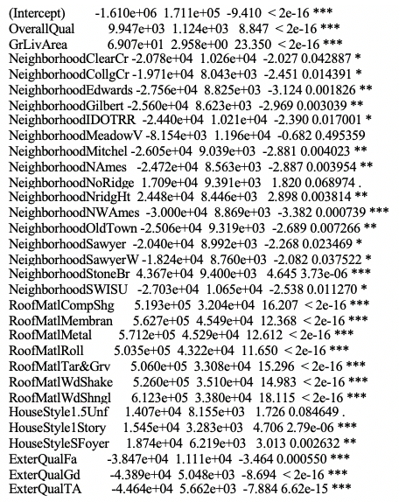
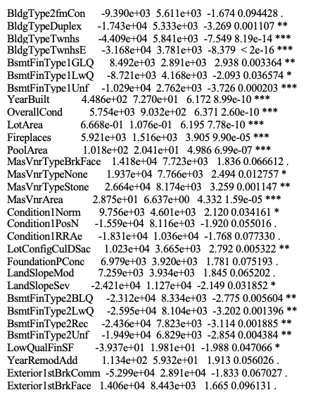
Significant coefficients

Slide 12
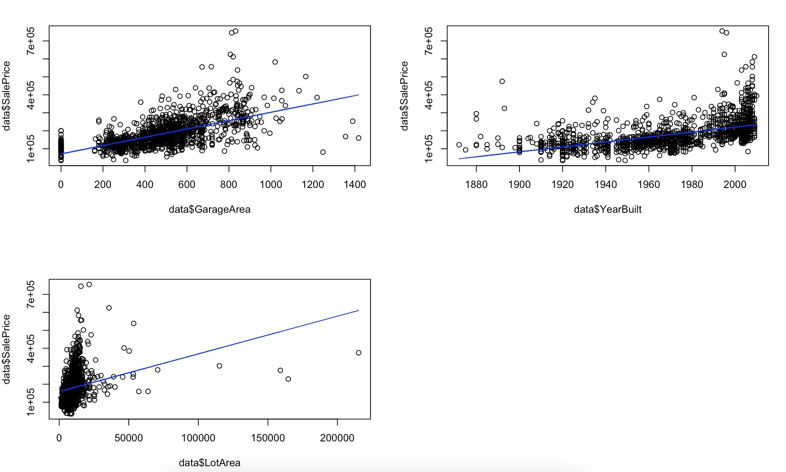
Linear Regression Model (Cont.)

Slide 13
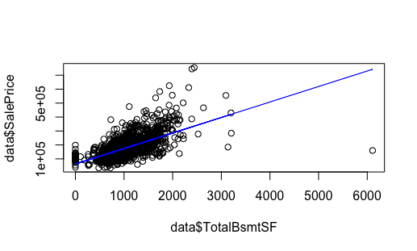
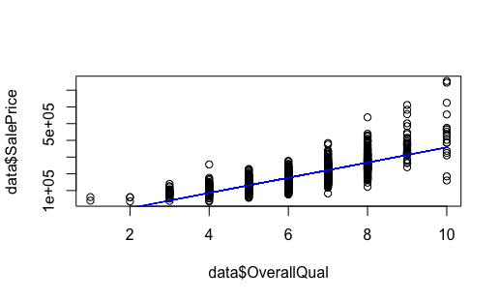

Slide 14
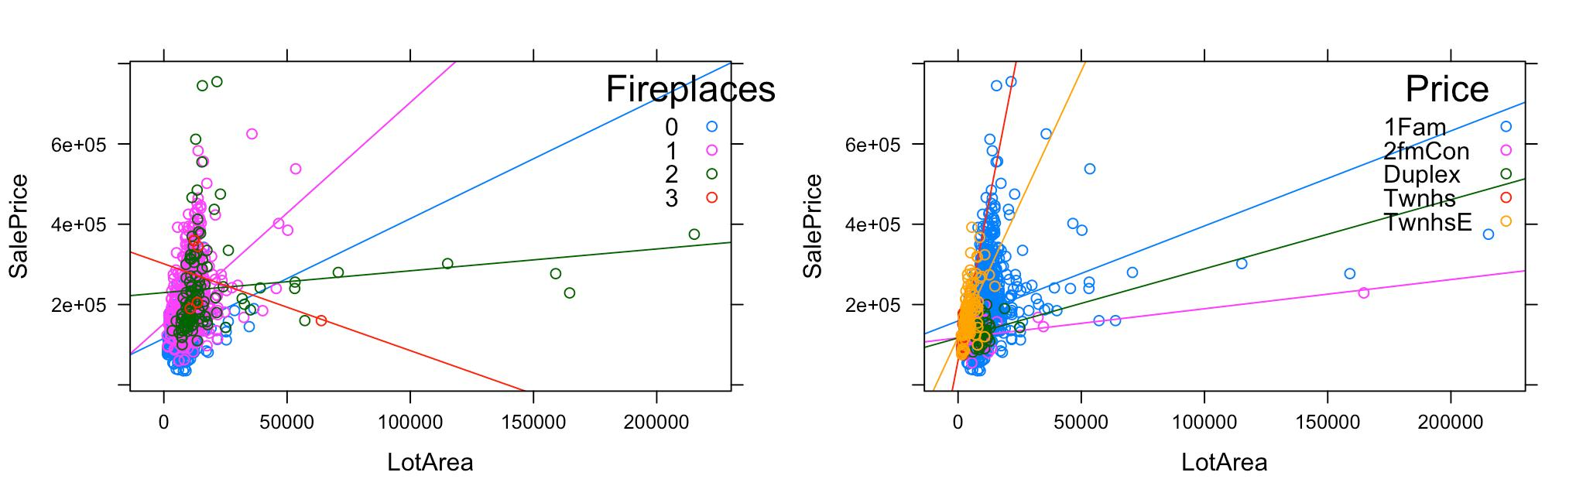
Linear Regression Model (Cont.)

Slide 15
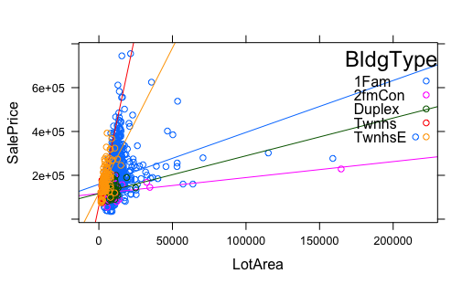
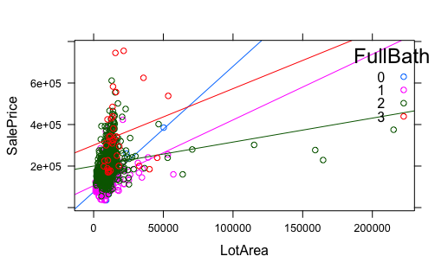

Slide 16
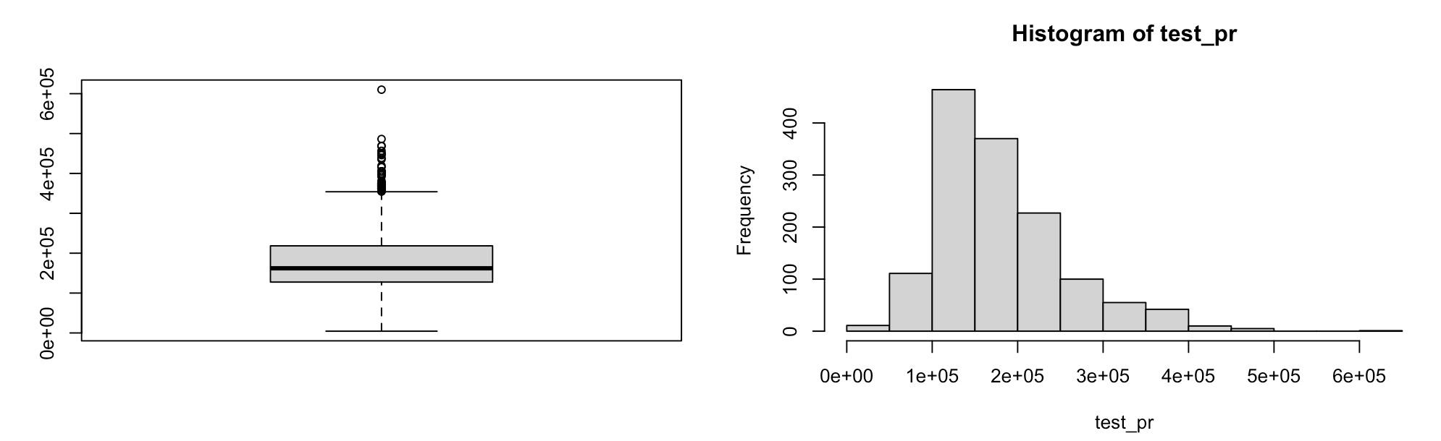
Prediction Summary Statistics
fivenum(test_pr): 4426.625 127542.799 162134.147 218400.246 610017.138
mean(test_pr):179839.9

Slide 17
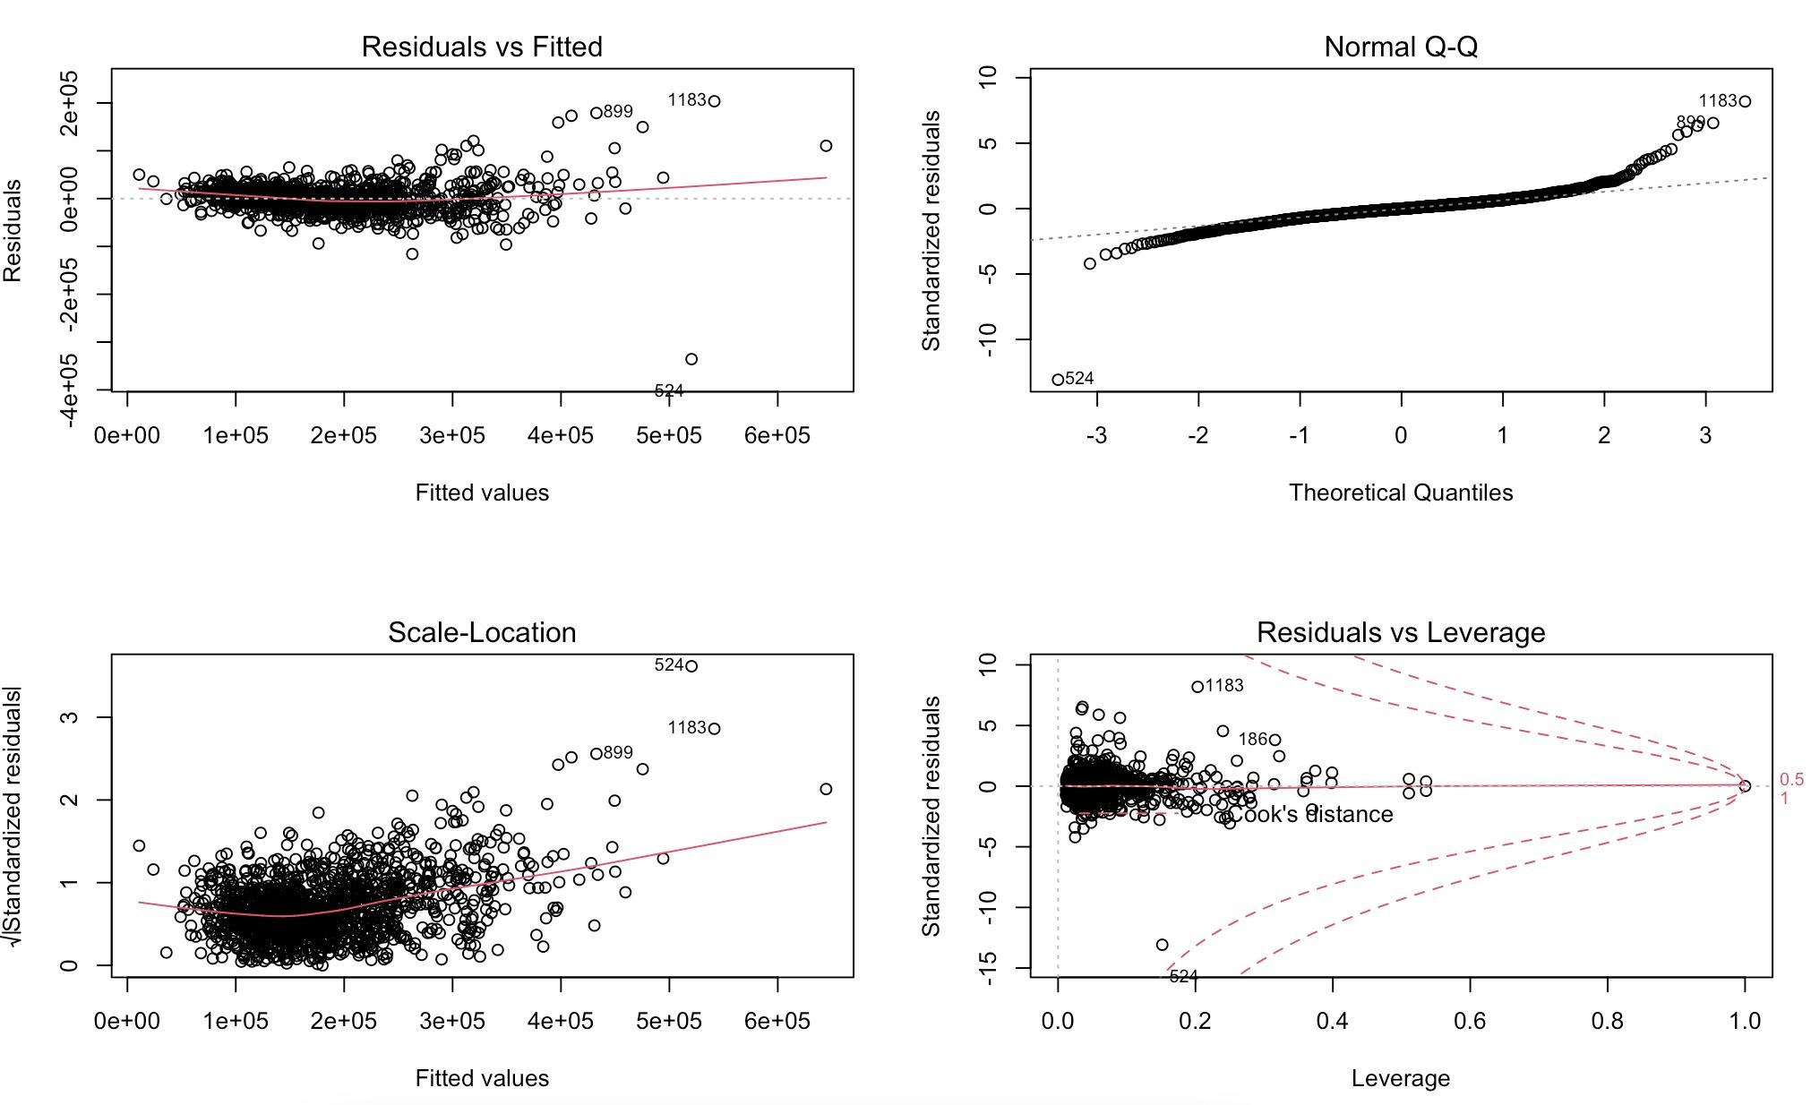
Shapiro Test
Using the residuals of the model we worked with; we used the Shapiro test to check the normally distribution.
W = 0.84879
P-value < 2.2e-16
This means that there is no enough evidence that data comes from normal distribution (p-value>0.05, Ho is rejected at 5% level). In the Normal Q-Q plot, most of the plots are nearly zero, going almost in a straight line, but there a bunch of outliers, especially at the right part of the graph.

Slide 18
Conclusion
The data (dependent variable) is not normally distributed. There is significant group of outliers, especially to the right side of the histogram or QQ plot. That is probably why we get such high MSE.
Initial dataset contains 79 explanatory variables. Using logic and subset selection techniques we were able to find a linear regression model that uses just 23 predictors and explains about 88 percent of the variation in target variable (Adjusted R-squared) with MSE 714564136.

Slide 19
Reference
Carnegie Mellon University, 1980, lib.stat.cmu.edu/datasets/boston.
De Cook, Dean. “Ames, Iowa: Alternative to the Boston Housing Data as an End of Semester Regression Project.” Journal of Statistics Education, 2011, jse.amstat.org/v19n3/decock.pdf.
Dublin, Robin. “Predicting House Prices Using Multiple Listings Data.” ResearchGate, 1998, www.researchgate.net/publication/5151497_Predicting_House_Prices_Using_Multiple_Listings_Data.
Truong, Quang, et al. “Housing Price Prediction via Improved Machine Learning Techniques.” Procedia Computer Science, Elsevier, 27 July 2020, www.sciencedirect.com/science/article/pii/S1877050920316318.
“Real Estate, Apartments, Mortgages & Home Values.” Zillow, www.zillow.com/.
“House Prices: Advanced Regression Techniques.” Kaggle, www.kaggle.com/c/house-prices-advanced-regression-techniques

